Slide 1

Silverlight
Asst.Prof.Dr.Derya BİRANT
328 - Web Based Windows Programming

Slide 2
Contents
1
Understanding Silverlight
2
Silverlight vs. Flash
3
Advantages of Silverlight
4
Silverlight Versions
5
Silverlight Framework
6
Examples

Slide 3
Web vs. Desktop Applications
Web is easily the most popular environment, but you won’t be able to duplicate many of the capabilities that desktop applications take for granted, such as animation, sound and video playback, and 3D graphics.
We can use JavaScript to respond on the client to focus changes, mouse movements, and other “real-time” events, but we still can’t build a complex interface that’s anywhere near as responsive as a window in a rich client application.

Slide 4





Richly Designed Web Interfaces
Purpose: to prepare an animated commercial or play a simple but richly designed interfaces directly in your browser.
This capability obviously isn’t a part of the ordinary HTML, CSS, and JavaScript standards.
It’s enabled by a browser plug-in, sometimes for a Java Applet, but most commonly for Flash content.

Slide 5

Understanding Silverlight
Silverlight is designed to overcome the limitations of ordinary HTML to allow developers to create more graphical and interactive applications.

Slide 6

Silverlight vs. Flash
Silverlight technology is a direct competitor to Flash.
Like Flash, Silverlight allows you to create interactive content that runs on the client, with support for dynamic graphics, media, and animation that goes far beyond ordinary HTML.
Like Flash, Silverlight is deployed using a lightweight browser plug-in and supports a wide range of different browsers and operating systems.
Notes:
Silverlight boasts a few architectural features that Flash can’t match.

Slide 7
Silverlight vs. Flash
Flash has a long history (more than ten years), beginning as a straightforward tool for adding animated graphics and for developing interactive content.
Before Silverlight, ASP.NET developers need to extend their websites using Flash content.
  Doing so requires a separate design tool, and a completely different programming language (ActionScript) and programming environment (Flex).
  It’s difficult to integrate ASP.NET content and Flash content.
Silverlight aims to give .NET developers a better option for creating rich web content.
Silverlight provides a browser plug-in with many similar features to Flash.
As a result, developers can write client-side code for Silverlight in the same environment and language they use for server-side code (such as C# and VB).

Slide 8
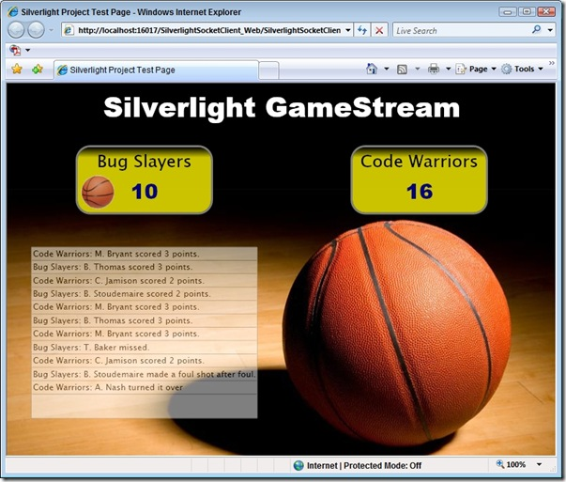

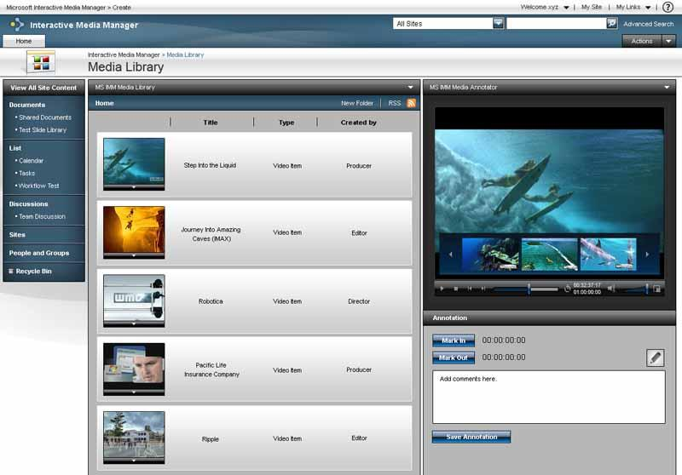
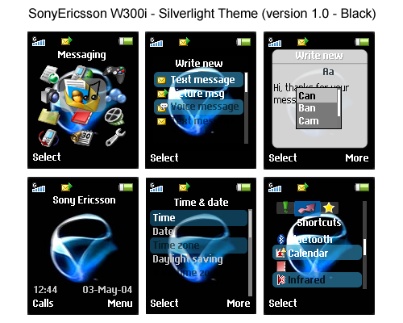
Silverlight Examples
Games
Dashboard
Media Manager
Mobil Interfaces

Slide 9
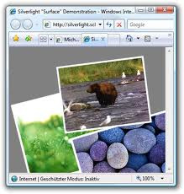
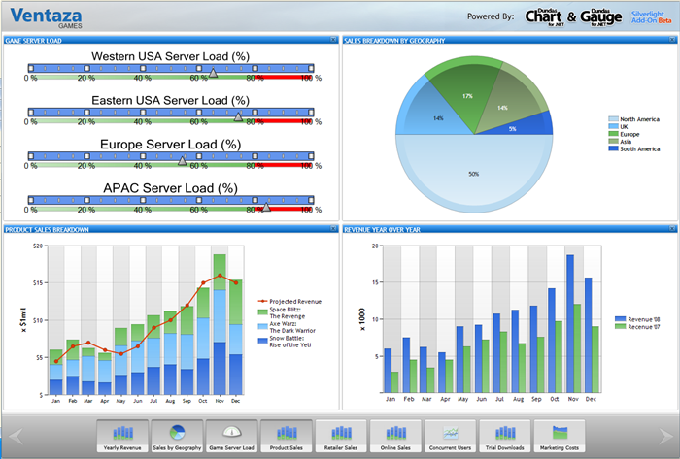

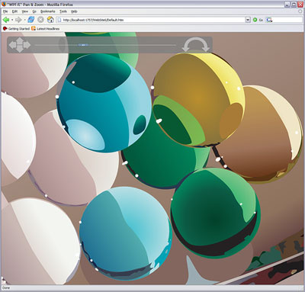

Silverlight Surface
Graphics
Silverlight Examples
Map
Another Examples

Slide 10
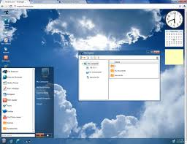

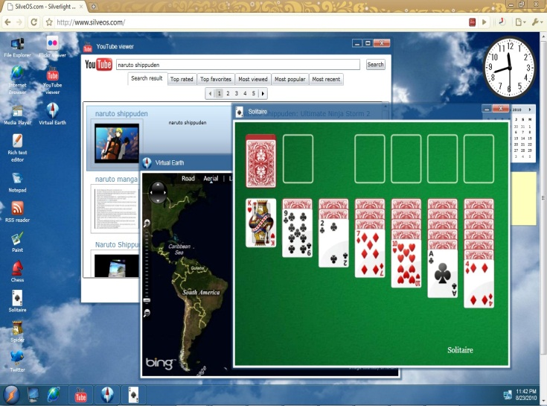
Silverlight Operating System ☺
SilverOS: It is is a website that simulates an operating system inside your web browser.
http://www.silveos.com/

Slide 11
Silverlight Examples
http://statemagic.com/Designer.aspx
http://www.iantech.net/aram/
http://silverlawone.blogspot.com/2011/03/bildvergleich-mithilfe-eines.html
http://www.visifire.com/silverlight_wpf_charts_gauges_designer.php?id=vg
http://www.coolwebcontrols.com/CWCDemoBannerFocusSpotlightSL4.aspx
http://www.edwardsmale.co.uk/Tetris
http://www.componentgo.com/projectservice/#/Views/ProjectPlanner
http://www.coolwebcontrols.com/CWCDemoBannerImageStackSL4.aspx
http://cpc.itenso.com/
http://marcinstypulski.studentlive.pl/
http://xamlui.com/

Slide 12
Silverlight Versions
Silverlight 1 included the 2D drawing features and the media playback features.
Silverlight 2, introduced a scaled-down CLR (Common Language Runtime), a subset of .NET Framework classes, and a user interface based on Windows Presentation Foundation (WPF)
Silverlight 3 and Silverlight 4 keep the same underlying infrastructure and simply add more features.
Silverlight 5 with over 40 new features (double click, WAV support, performance improvements, etc.) (December 9, 2011)

Slide 13


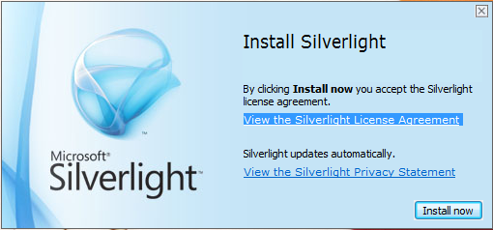
Silverlight Plug-in
Silverlight uses a familiar technique to go beyond the capabilities of standard web pages - it uses a lightweight browser plug-in.
The user needs to install just a single component to see content.
Installing the plug-in requires a small download (about 6 MB) and forces the user to confirm the operation in at least one security dialog box.
That’s easy to download.
  http://www.microsoft.com/silverlight/
  http://www.silverlight.net/

Slide 14
Advantages of Silverlight
Supports Data Binding and Web Services
Supports Drawing of vector graphics and 3D transformations
Supports for creating storyboards and animations
Supports for using text boxes and buttons and even creating own controls
Layout support
Controls styling
Change appearance of controls
Supports video and audio share via webcams and microphone
Supports high quality media streaming with a low-cost delivery
Supports to create applications for windows and symbian based mobile phones

Slide 15
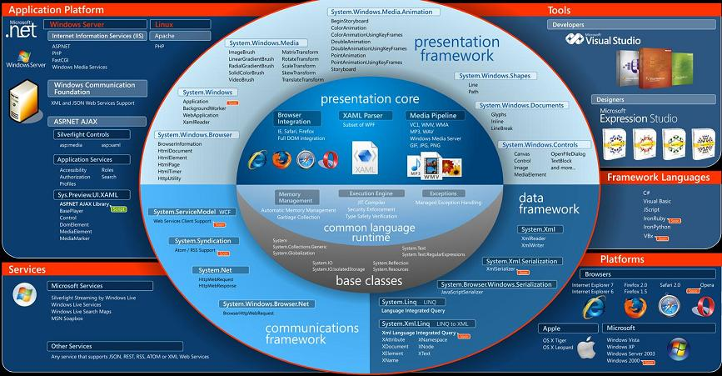

Framework

Slide 16
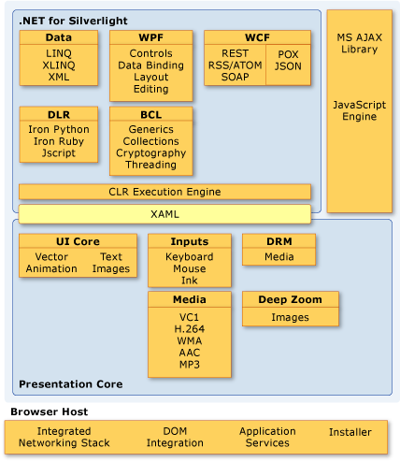
Silverlight Framework

Slide 17
Silverlight has many Features
2D Drawing: Draw shapes and paths, manipulate this content on the client side.
Controls: Controls, including buttons, text boxes, lists, can be restyled with custom visuals.
Animation: Silverlight has a time-based animation model.
Media: Silverlight provides playback of WMA, WMV7-9, MP3 audio, VC-1 etc. Show video in full-screen mode.
The Common Language Runtime: Garbage collector, a JIT (just-in-time) compiler, support for generics, threading, and so on.
Networking: Silverlight applications can call web services (.asmx) or WCF services. They can open direct socket connections for fast two-way communication.
Data binding: It can provide a convenient way to display large amounts of data with minimal code.

Slide 18
Silverlight System Requirements
Windows computers: Silverlight works on PCs with Windows 7, Windows Vista and Windows XP. The minimum browser versions that Silverlight 2 supports are Internet Explorer 6 and Firefox 1.5. Silverlight will also work in Windows 2000, but only with Internet Explorer 6.
Mac computers: Silverlight works on Mac computers with OS X 10.4.8 or later, provided they have Intel hardware.
Linux computers: The Mono team is currently developing Moonlight, a free and open-source implementation of the Silverlight. Earn more, visit http://www.mono-project.com/Moonlight

Slide 19
Silverlight Applications
In order to create Silverlight applications, you need Visual Studio 2010.
You can also install Microsoft Silverlight Tools to use in Visual Studio 2008.
Alternatively, you can use Expression Blend - a graphically oriented design tool - to build and test Silverlight applications.

Slide 20
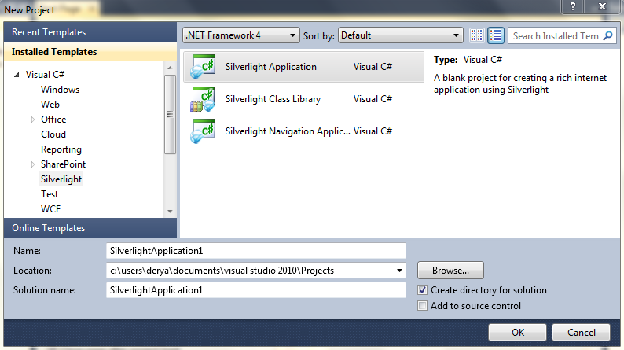
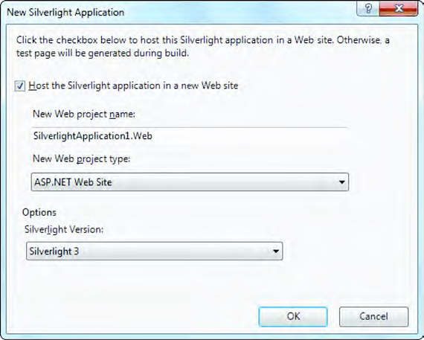
Creating a Silverlight Solution
Select File ➤ New ➤ Project
Select the Silverlight Application template.
It’s a good idea to use the “Create directory for solution” option, so you can group together the two projects that Visual Studio will create
  one for the Silverlight assembly and
  one for the ASP.NET website.

Slide 21
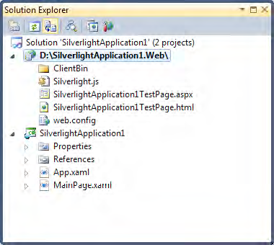
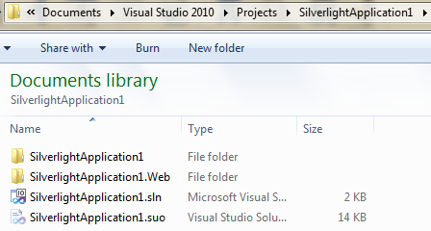
Creating a Silverlight Solution
You’ll end up with a single solution that holds two projects
  a familiar ASP.NET website, and
  a dedicated Silverlight project.

Slide 22
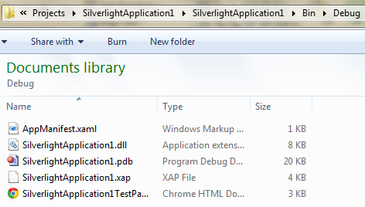
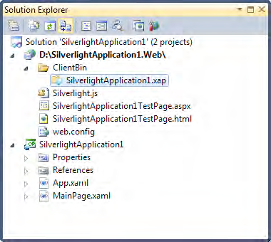
When you run the application
Silverlight project is compiled into a DLL file.
A project named SilverlightApplication1, the csc.exe compiler will create the file SilverlightApplication1.dll
Next, The assembly is placed into a special application package called a XAP file.
The XAP file includes the DLL assembly for your project. If you add other content files to your Silverlight project (for example, images), they will be automatically embedded in the XAP file.
Finally, Visual Studio copies the XAP file to the ClientBin folder in the ASP.NET website.

Slide 23
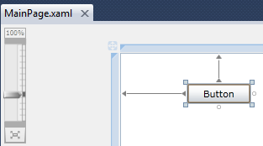
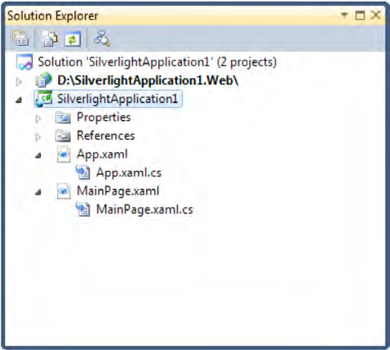
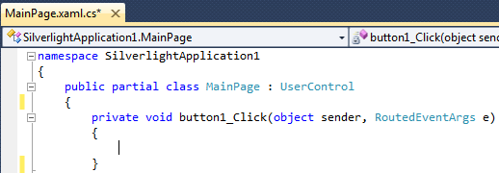
App.xaml and App.xaml.cs: These files allow you to configure your Silverlight application. They allow you to define resources that will be made available to all the pages in your application and They allow you react to application events such as startup, shutdown, and error conditions.
MainPage.xaml: This file defines the user interface (the collection of controls, images, and text) that will be shown for your first page.
MainPage.xaml.cs: This file includes the code that underpins your first page, including the event handlers that react to user actions. Like all the code in a Silverlight application, these events run on the client side.

Slide 24
XAML
XAML stands for eXtensible Application Markup Language
The XAML constructs an instance of the UserControl class, associates it with the class named MainPage and initializes the DesignWidth property to 400 and the DesignHeight property to 300.Next, the XAML constructs an instance of the Grid class, assigns the name LayoutRoot to the Grid, and sets the Background to white.
<UserControl x:Class="DrawEllipse.MainPage"
xmlns="http://schemas.microsoft.com/winfx/2006/xaml/presentation"
xmlns:x="http://schemas.microsoft.com/winfx/2006/xaml"
xmlns:d="http://schemas.microsoft.com/expression/blend/2008"
xmlns:mc="http://schemas.openxmlformats.org/markup-compatibility/2006"
mc:Ignorable="d"
d:DesignHeight="300" d:DesignWidth="400">
<Grid x:Name="LayoutRoot" Background="White">
</Grid>
</UserControl>

Slide 25
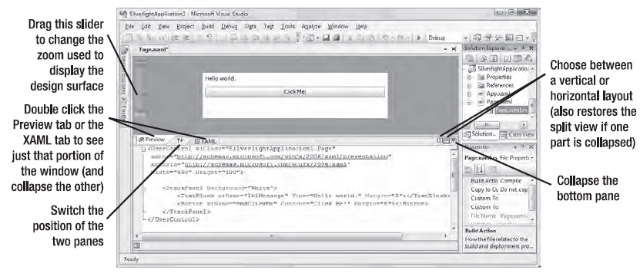
Designing a Silverlight Page
Visual Studio gives you two ways to look at every XAML file:
  as a visual preview (known as the design surface) or
  the underlying markup (known as the source view).
You can start designing your XAML page by dragging controls from the Toolbox and dropping them onto the design surface.

Slide 26
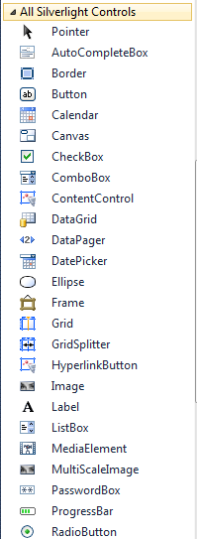

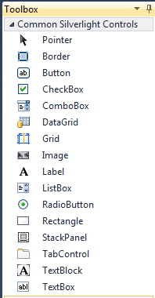

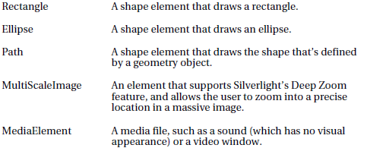
ToolBox

Slide 27
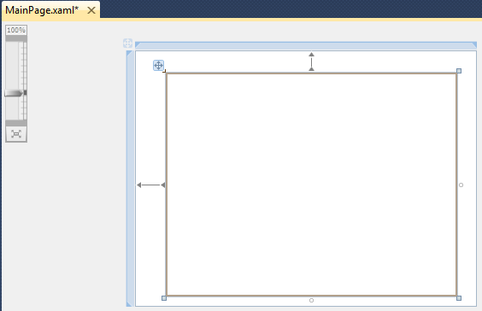
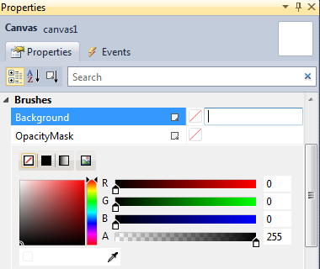
Drawing Ellipse
Insert Canvas control
Change Background color

Slide 28
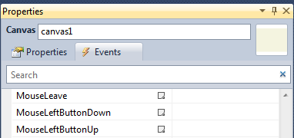
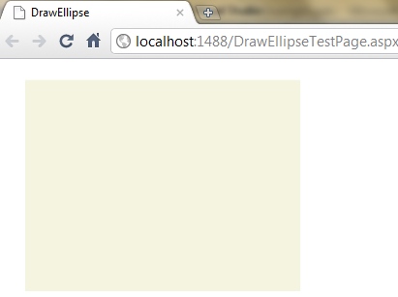
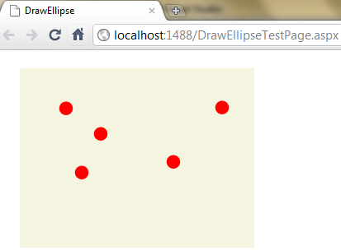
Drawing Ellipse
Write code to the MouseLeftButtonDown event
Ellipse ellipse = new Ellipse();
ellipse.Fill = new SolidColorBrush(Colors.Red);
ellipse.Width = 20;
ellipse.Height = 20;
Point point = e.GetPosition(this);
ellipse.SetValue(Canvas.TopProperty, point.Y - ellipse.Height);
ellipse.SetValue(Canvas.LeftProperty, point.X - ellipse.Width);
canvas1.Children.Add(ellipse);

Slide 29
Animation
Storyboard Class: The storyboard manages the timeline of your animation.
You can use a storyboard to group multiple animations.
It has the ability to control the
  playback of animation storyboard.Begin();
  pausing it, storyboard.Pause();
  storyboard.Resume();
  stopping it, storyboard.Stop();
  changing its position storyboard.Seek();

Slide 30
Animation
Animation class
  DoubleAnimation: if you want to change a property that uses the double data type. (which is one of the most common scenarios)
  ColorAnimation: If you want to modify the color.
  PointAnimation: It uses point value i.e. X, Y values for line segments and curves.

Slide 31
Animation
From: Sets the starting values for your animation.
To: Sets the ending value for your animation
By: Instead of using To, use By to create a cumulative animation.
By value of 10, the rectangle will grow 10 pixels wider than its current.
Duration: The length of time the animation runs, from start to finish.
AutoReverse: If true, the animation will play out in reverse once it’s complete.
RepeatBehavior: Allows you to repeat an animation a specific number of times.
BeginTime: Sets a delay that will be added before the animation starts (as a TimeSpan).
SpeedRatio: Increases or decreases the speed of the animation.
FillBehavior: Determines what happens when the animation ends.

Slide 32
private void Page_Loaded(object sender, RoutedEventArgs e)
{
Random rand = new Random();
for (int i = 0; i < 10; i++)
{
// Create a new rectangle.
Rectangle rect = new Rectangle();
rect.Fill = new SolidColorBrush(Colors.Red);
// Size and place it randomly.
rect.Width = rand.Next(10, 40);
rect.Height = rand.Next(10, 40);
Canvas.SetTop(rect, rand.Next((int)(canvas1.Height - rect.Height)));
Canvas.SetLeft(rect, rand.Next((int)(canvas1.Width - rect.Width)));
// Handle clicks.
rect.MouseLeftButtonDown += AnimasyonBaslasin;
// Add it to the Canvas.
canvas1.Children.Add(rect);
}
}
private void AnimasyonBaslasin(object sender, MouseButtonEventArgs e)
{
Rectangle rect = (Rectangle)sender;
// Create the storyboard for the rectangle.
Storyboard storyboard = new Storyboard();
// Create the animation for moving the rectangle.
DoubleAnimation fallingAnimation = new DoubleAnimation();
Storyboard.SetTarget(fallingAnimation, rect);
Storyboard.SetTargetProperty(fallingAnimation, new PropertyPath("(Canvas.Top)"));
fallingAnimation.To = canvas1.Height - rect.Height;
fallingAnimation.Duration = TimeSpan.FromSeconds(2);
storyboard.Children.Add(fallingAnimation);
// Create the animation for changing the rectangle's color.
ColorAnimation colorAnimation = new ColorAnimation();
Storyboard.SetTarget(colorAnimation, rect.Fill);
Storyboard.SetTargetProperty(colorAnimation, new PropertyPath("Color"));
colorAnimation.To = Colors.Green;
colorAnimation.Duration = TimeSpan.FromSeconds(2);
storyboard.Children.Add(colorAnimation);
// Track the rectangle.
animatedShapes.Add(storyboard, rect);
// React when the storyboard is finished.
storyboard.Completed += AnimasyonBitsin;
// Start the storyboard.
storyboard.Begin();
}
private void AnimasyonBitsin(object sender, EventArgs e)
{
// Stop the animation but keep the new position.
Storyboard storyboard = (Storyboard)sender;
Rectangle rect = animatedShapes[storyboard];
double newTop = Canvas.GetTop(rect);
storyboard.Stop();
Canvas.SetTop(rect, newTop);
((SolidColorBrush)rect.Fill).Color = Colors.LightGray;
animatedShapes.Remove(storyboard);
}
private Dictionary<Storyboard, Rectangle> animatedShapes = new Dictionary<Storyboard, Rectangle>();

Slide 33
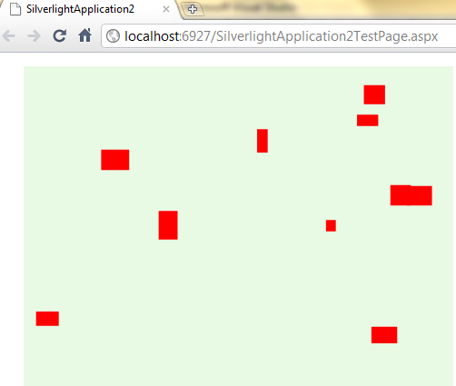
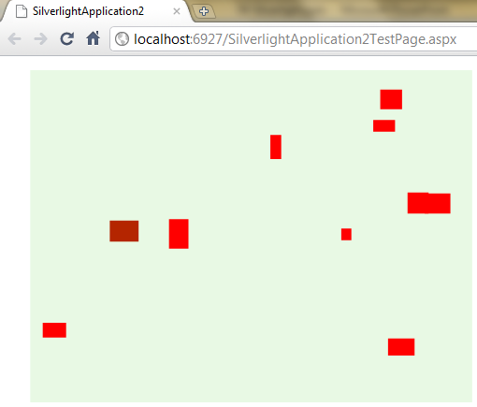
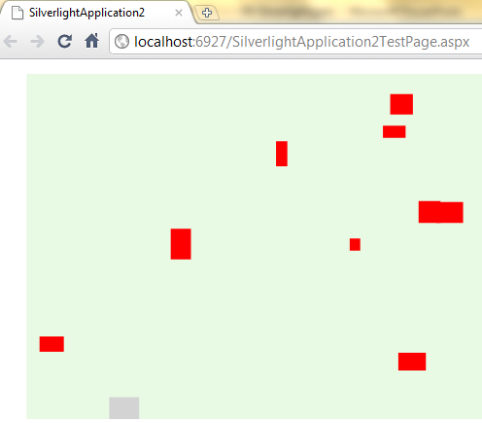
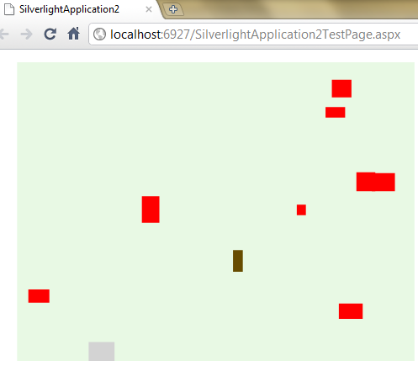
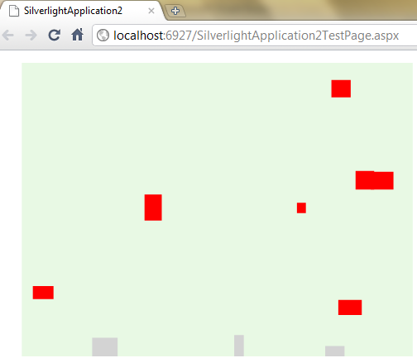
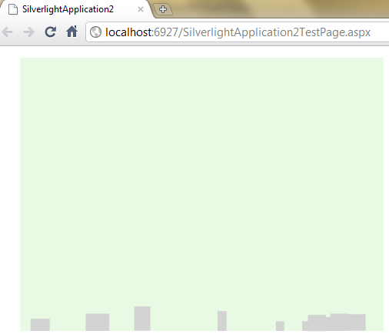
Example – Falling Down

Slide 34
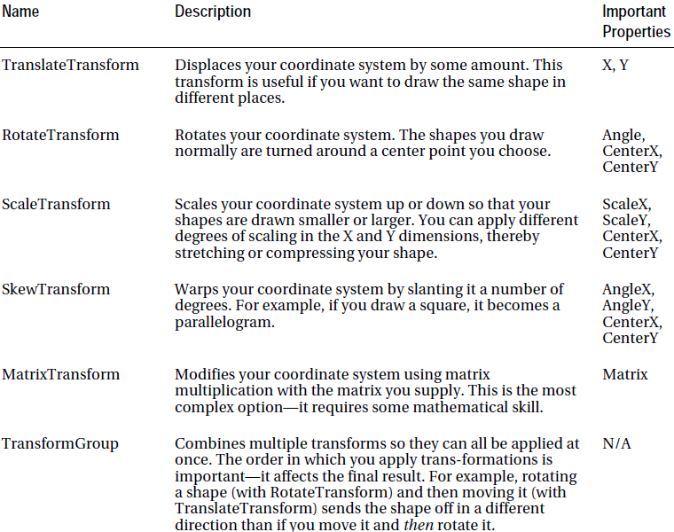
Transforms
Use transforms to stretch, rotate, skew, and otherwise manipulate the shapes, images, and text.

Slide 35
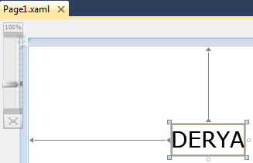
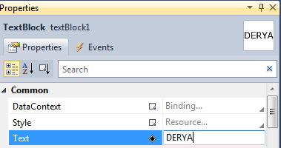
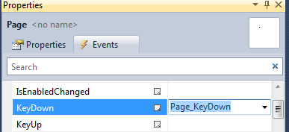
Transforms
Drag and Drop TextBlock
Open KeyDown event
private void Page_KeyDown(object sender, KeyEventArgs e)
{
if (e.Key == Key.A) // A-Key (Left)
rotateTransform.Angle -= 3.0;
else if (e.Key == Key.D) // D-Key (Right)
rotateTransform.Angle += 3.0;
else if (e.Key == Key.S) // S-Key (Down)
{
scaleTransform.ScaleX *= .97;
scaleTransform.ScaleY *= .97;
}
else if (e.Key == Key.W) // W-Key (Up)
{
scaleTransform.ScaleY *= 1.03;
scaleTransform.ScaleX *= 1.03;
}
else if (e.Key == Key.R) // R-Key (Reset)
{
InitializeScaleTransform();
InitializeRotateTransform();
}
}

Slide 36
private ScaleTransform scaleTransform = new ScaleTransform();
private RotateTransform rotateTransform = new RotateTransform();
public Page1()
{
InitializeComponent();
InitializeScaleTransform();
InitializeRotateTransform();
InitializeTransformGroup();
}
private void InitializeScaleTransform()
{
scaleTransform.ScaleX = 1.0;
scaleTransform.ScaleY = 1.0;
scaleTransform.CenterX = 50.0;
scaleTransform.CenterY = 50.0;
}
private void InitializeRotateTransform()
{
rotateTransform.Angle = 0.0;
rotateTransform.CenterX = 150.0;
rotateTransform.CenterY = 50.0;
}
private void InitializeTransformGroup()
{
TransformGroup transformGroup = new TransformGroup();
transformGroup.Children.Add(rotateTransform);
transformGroup.Children.Add(scaleTransform);
textBlock1.RenderTransform = transformGroup;
}

Slide 37
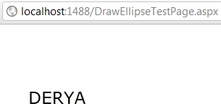
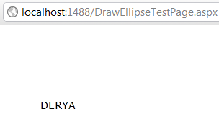
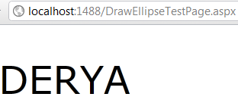
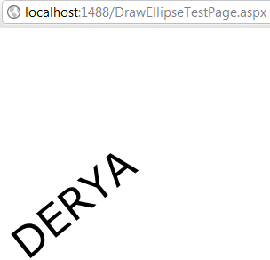
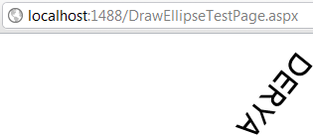

Slide 38
See you next week!
Asst.Prof.Dr.Derya BİRANT
328 - Web Based Windows Programming

